Slide 1




Deadline to enroll
May 28th
Contact details:
wadfgreece@gmail.com
WADF Greece

Slide 2

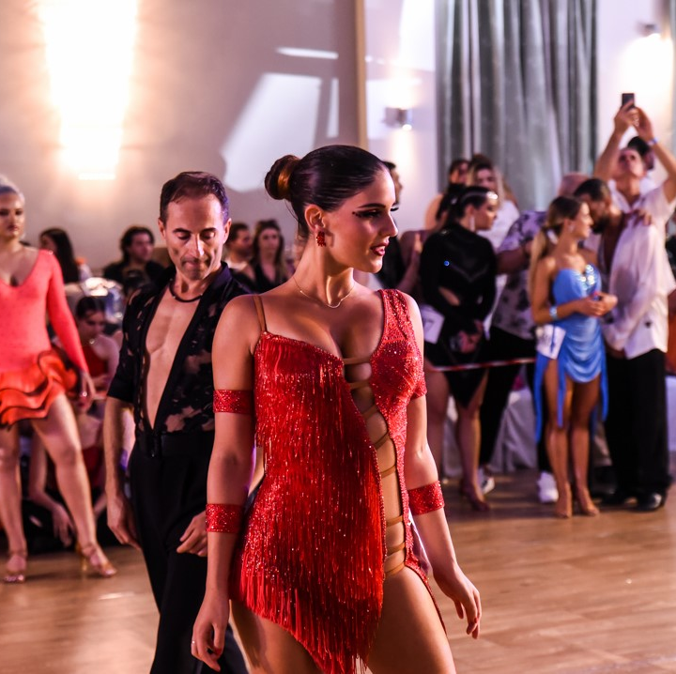
WADF World Championship Athens 2025, presents a prestigious stage for dancers, coaches, and studio owners from around the globe to showcase their talent of their students but also their dedication, and passion for dance. This WADF granted title event celebrates the beauty of movement across all dance styles, providing a comprehensive opportunity for both amateurs of all ages and levels (Beginners - Rising Stars) and professional dancers to compete on an international stage for top honors.
Join us for an unforgettable experience where poise, rhythm, and artistry come alive on the world stage. Whether you are a competitor, coach, or studio owner, this competition promises to be a momentous occasion in your dance journey.
As a dancer, whether you specialize in ballet, jazz, hip-hop, contemporary, ballroom, Latin, or any other genre, this competition offers you the opportunity to perform in front of an international audience and a panel of distinguished judges. The competition is meticulously organized to ensure objective and fair results and to showcase the artistic and technical skills of each participant, making it an ideal venue for dancers seeking to elevate their craft and gain recognition in the dance community.
The WADF World Championship Athens 2025 invites you to bring your expertise and coaching to the forefront as you guide and support your students on the dance floor. This competition is a unique and incomparable opportunity for you to exchange dance knowledge, choreographic ideas and new standards, since coaches and dancers from many different countries in Europe, Africa and Asia participate!
Competitors will vie for the coveted WADF Grand Title, a recognition that signifies the pinnacle of dance achievement. The World Championship Title is not merely a trophy but a mark of distinction that echoes the commitment, artistry, and mastery of the winning dancers. Claiming this title is an honor that will reverberate through your students’ amateur dance pursuits as well as your professional career.

Slide 3
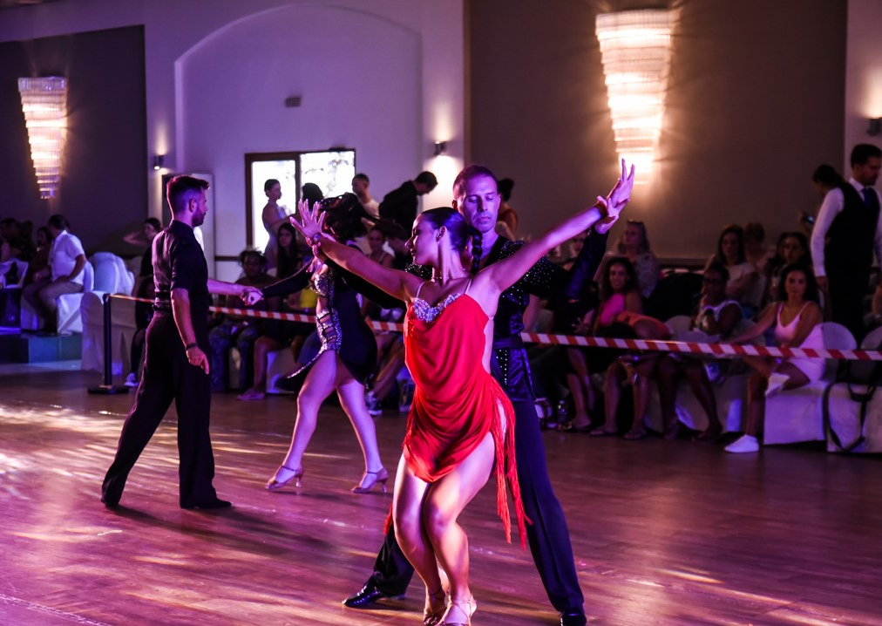
WORLD CHAMPIONSHIP CATEGORIES
Teacher - Student
Latin
Standard
Caribbean
Swing Genre
Argentine Tango
Show Dance
And many more

Slide 4
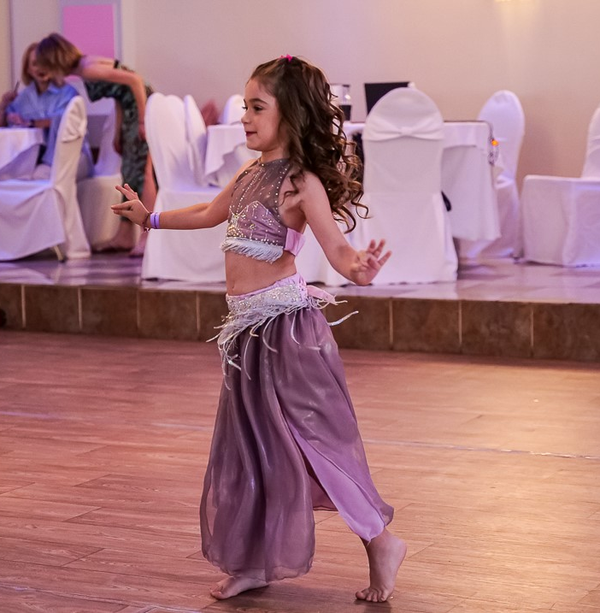
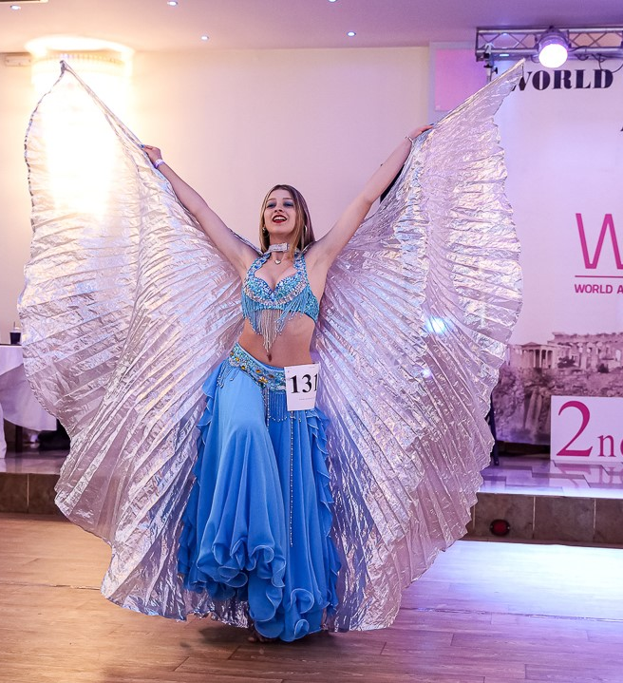
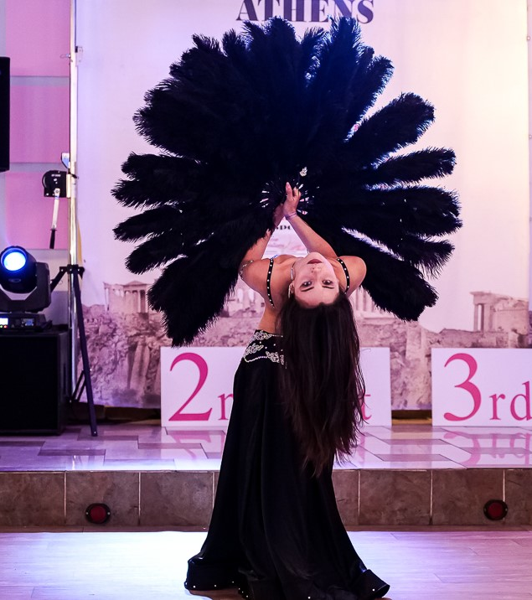
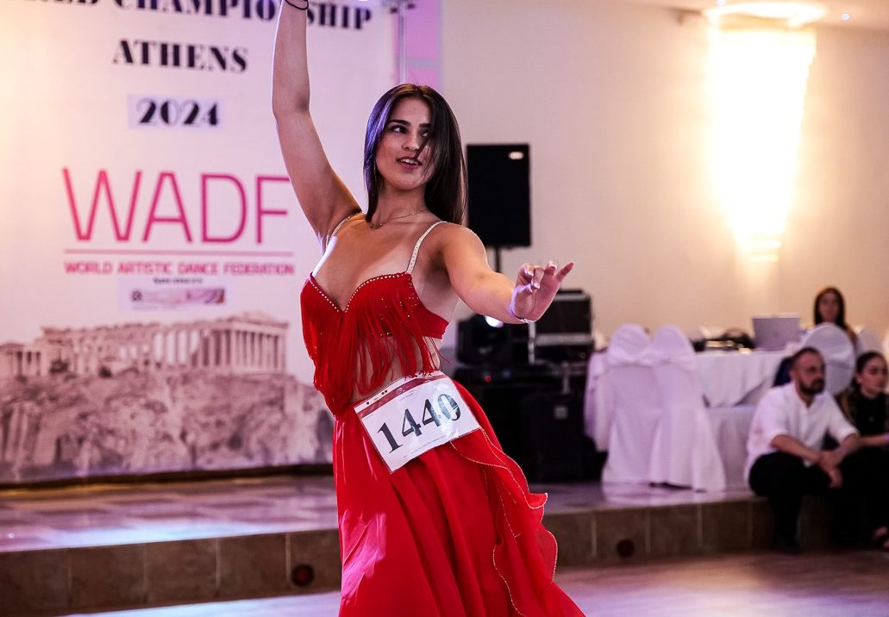
WORLD CHAMPIONSHIP CATEGORIES
Belly Dance

Slide 5
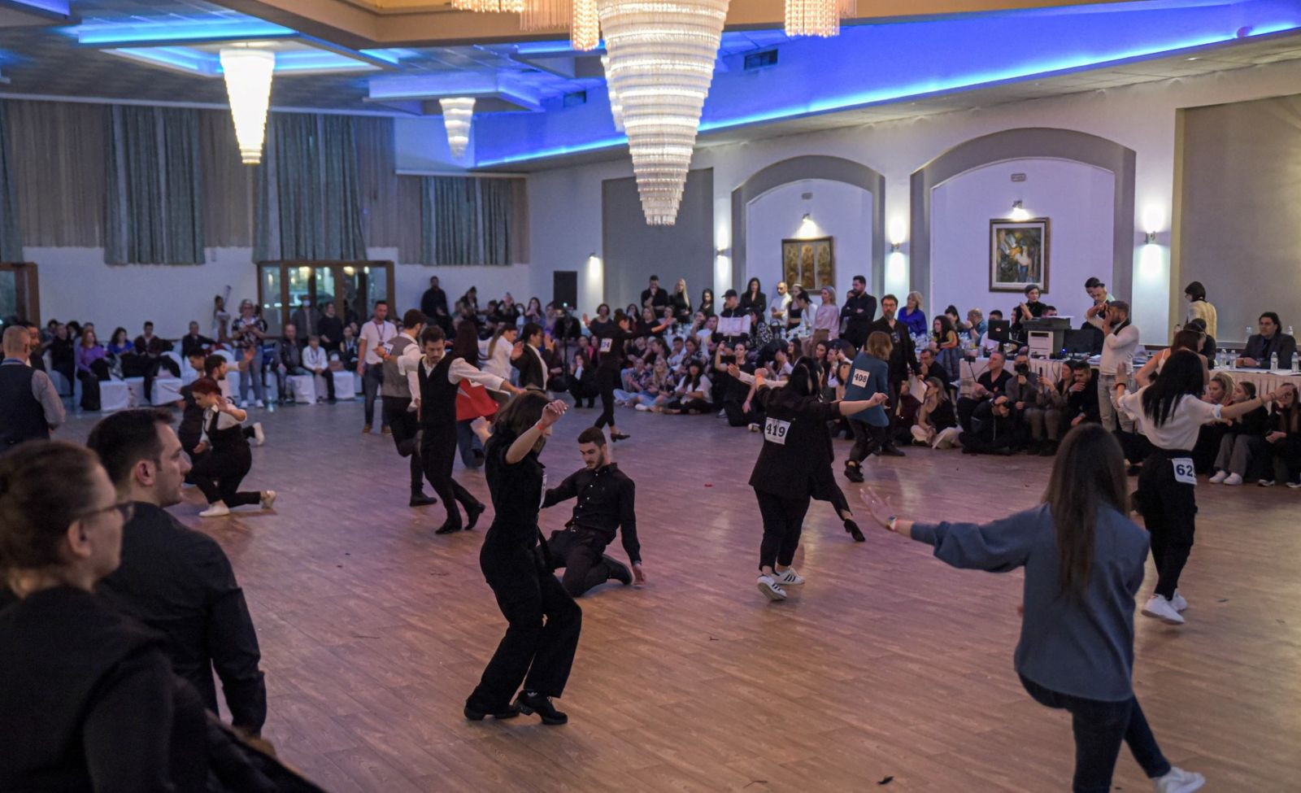
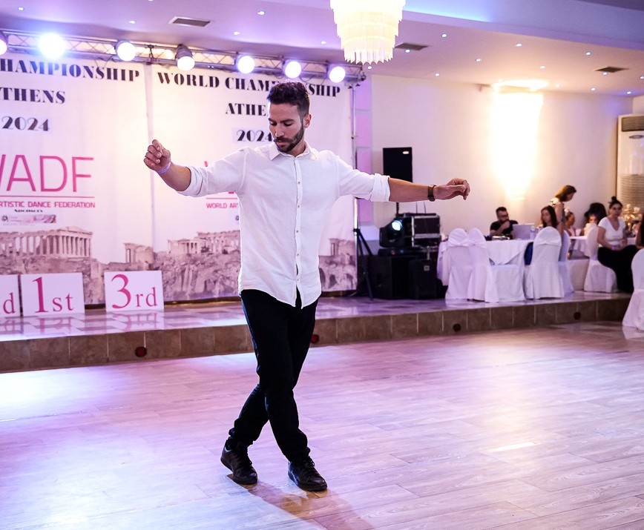
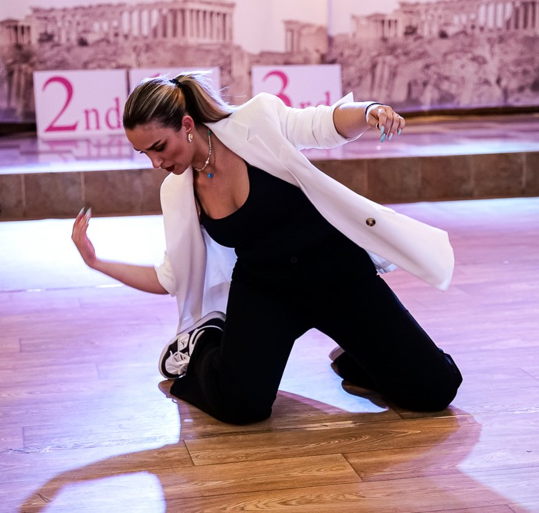
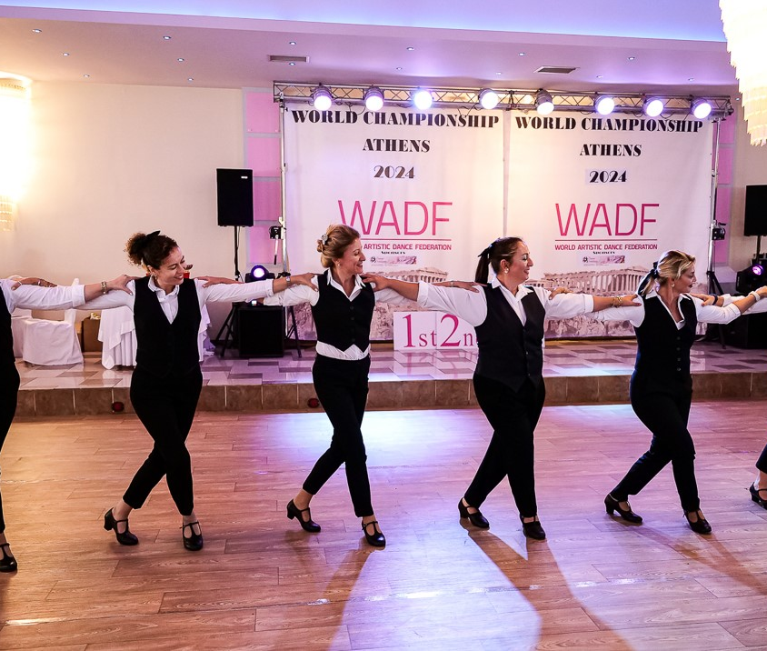
WORLD CHAMPIONSHIP CATEGORIES
Zeimpekiko
Folklore
Greek Dances

Slide 6
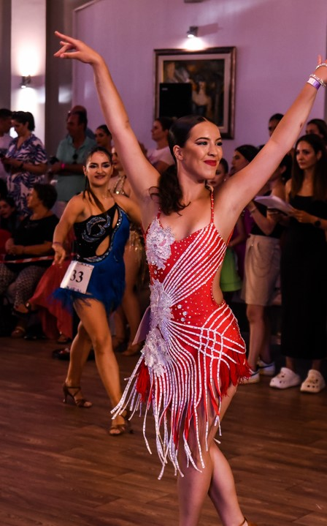
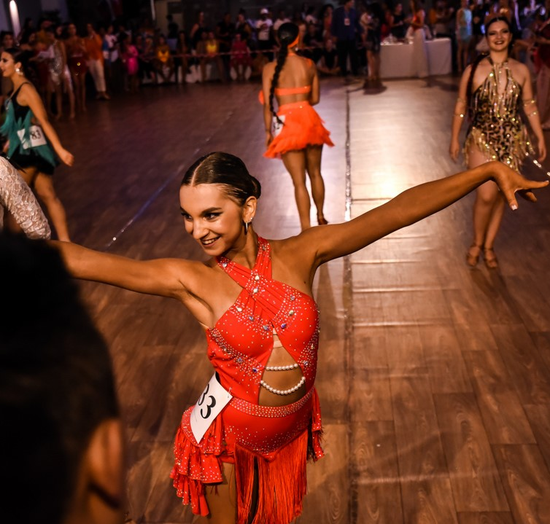
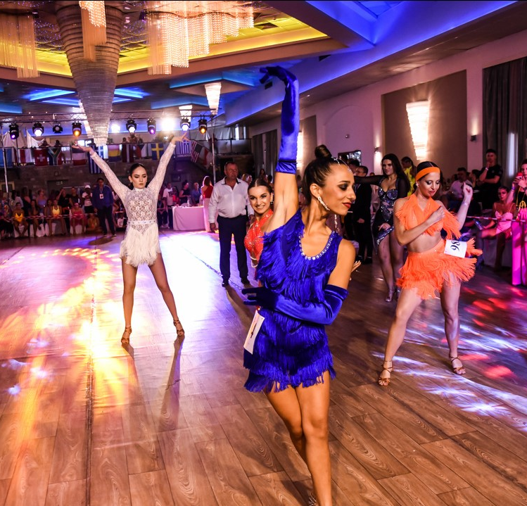
WORLD CHAMPIONSHIP CATEGORIES
Mambo on 1
Mambo on 2
Bolero

Slide 7
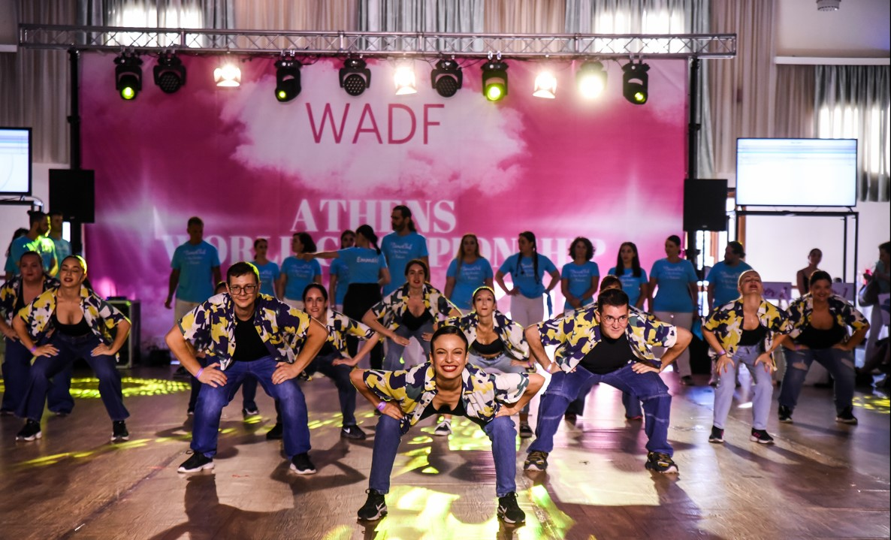
WORLD CHAMPIONSHIP CATEGORIES
AEROBIC ENERGY DANCE SHOW
Experience the Excitement

Slide 8
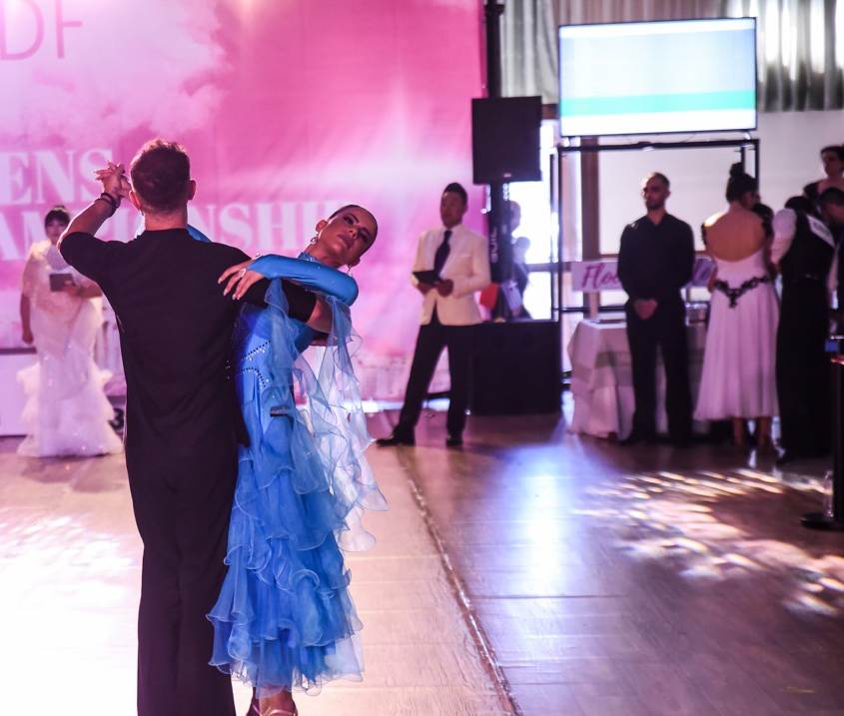
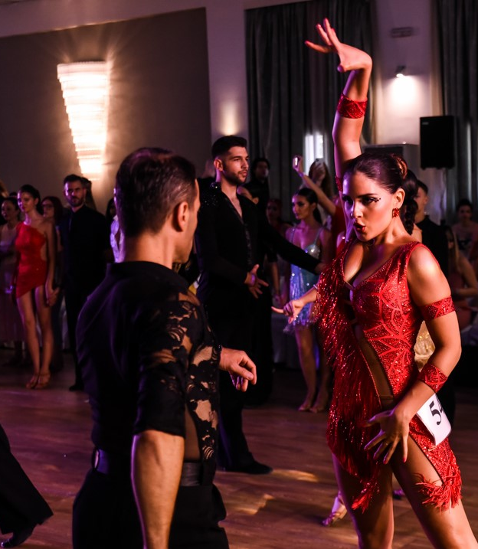
WORLD CHAMPIONSHIP CATEGORIES
5-dance Standard Int. Style
5-dance Latin Int. Style

Slide 9
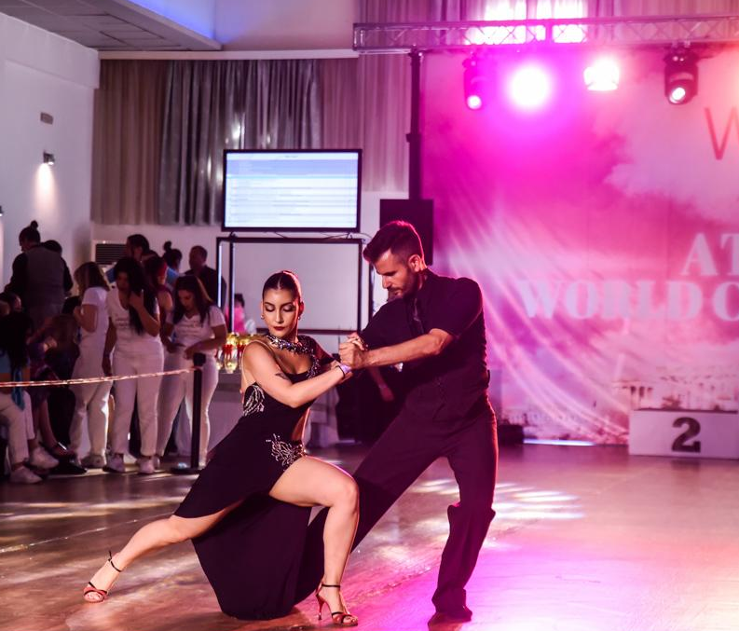
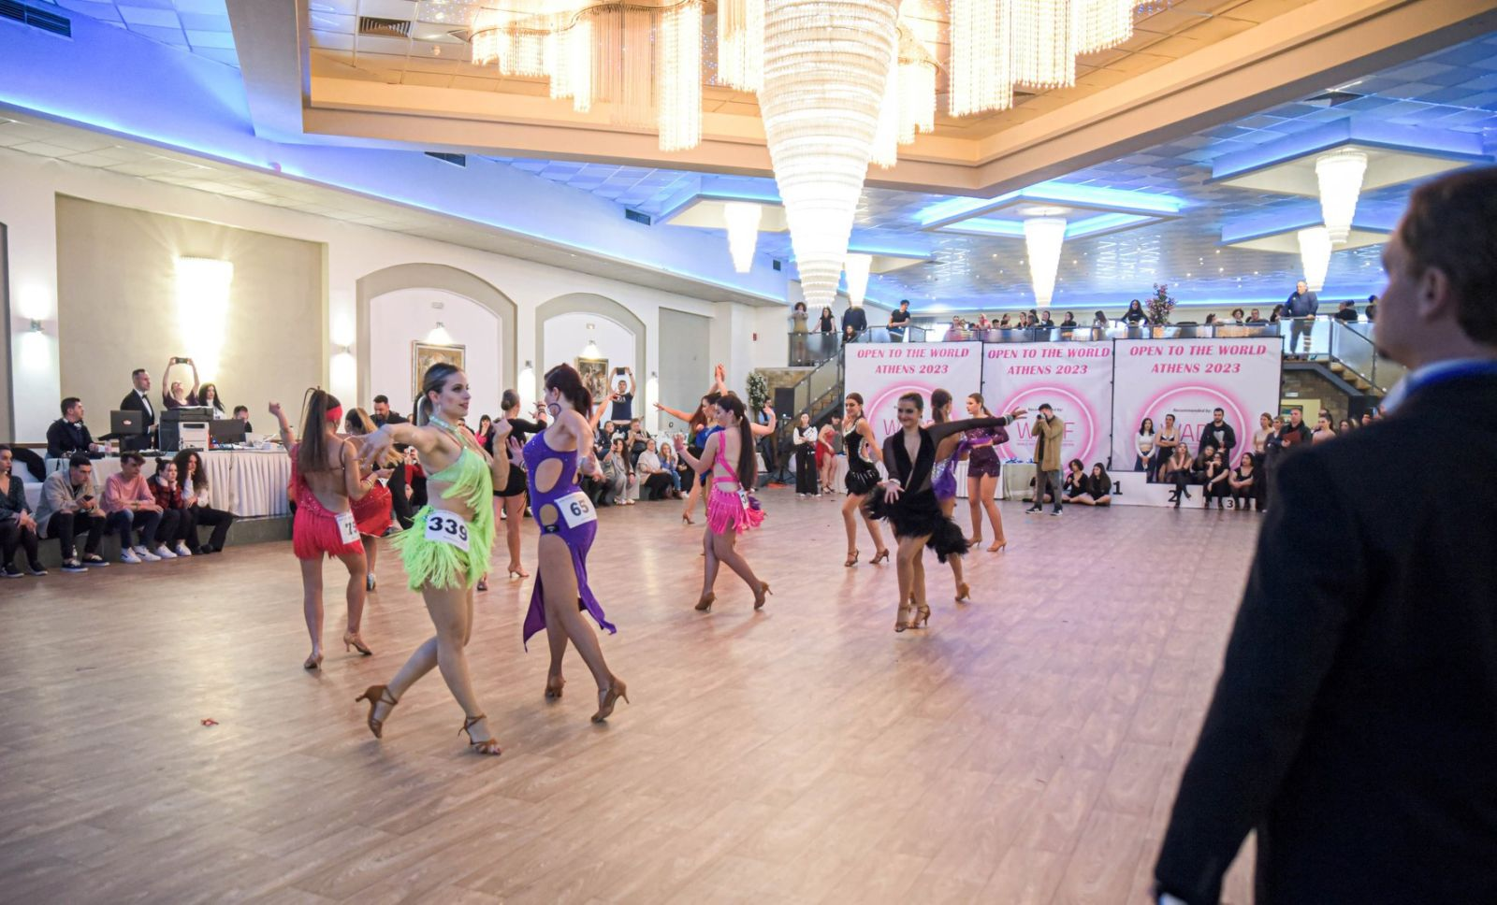
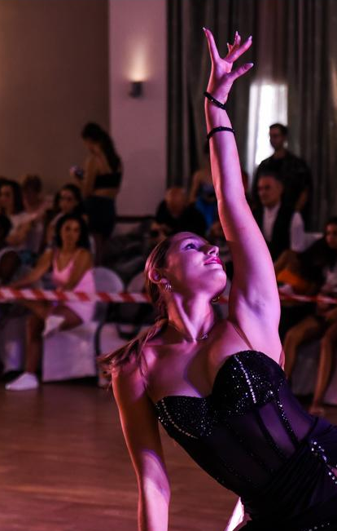
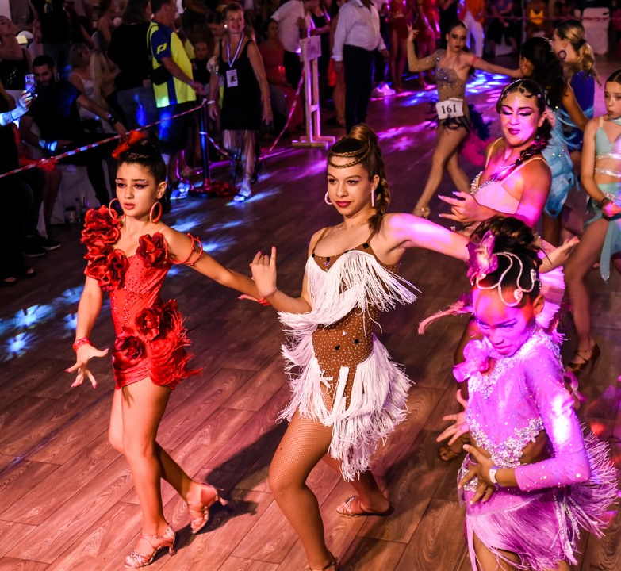
WORLD CUP CATEGORIES One Dance Artistic Ballroom
Latin
Standard
Caribbean
Swing Genre
Argentine Tango
Show Dance

Slide 10
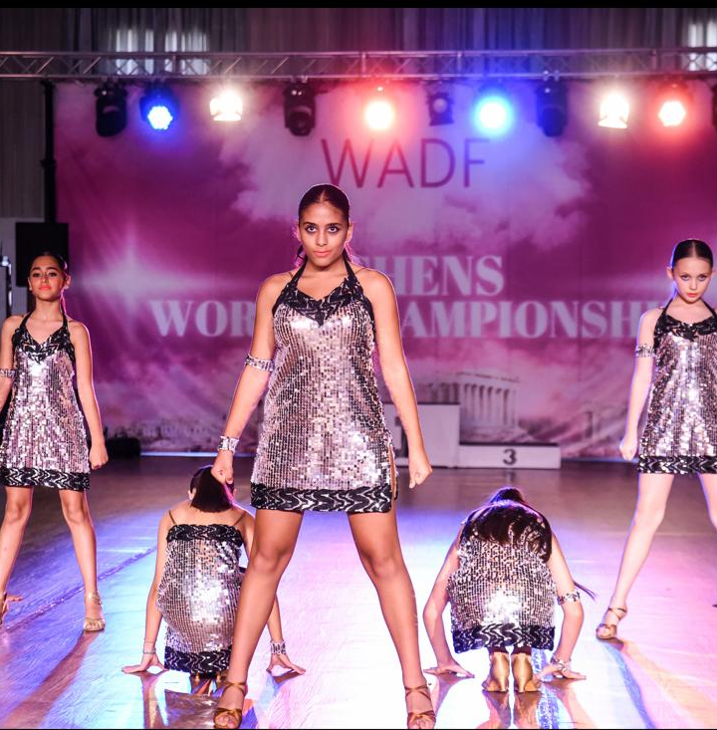
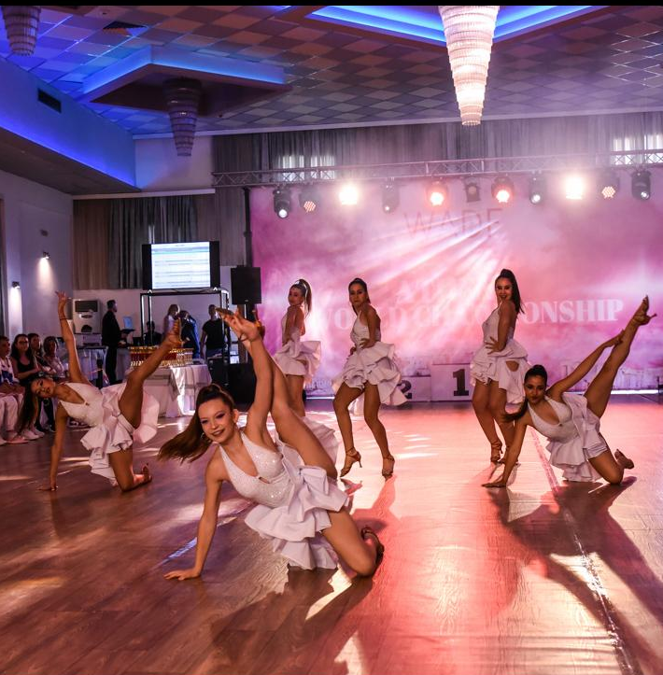
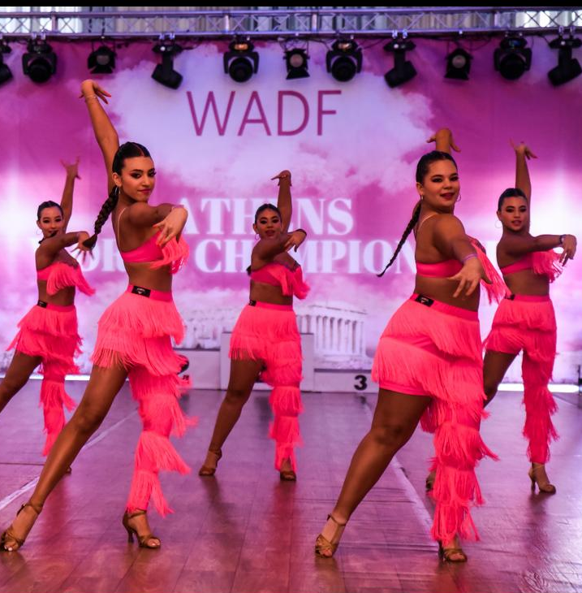
WORLD CUP CATEGORIES
ALL LADIES SYNCHRO FORMATION LATIN

Slide 11
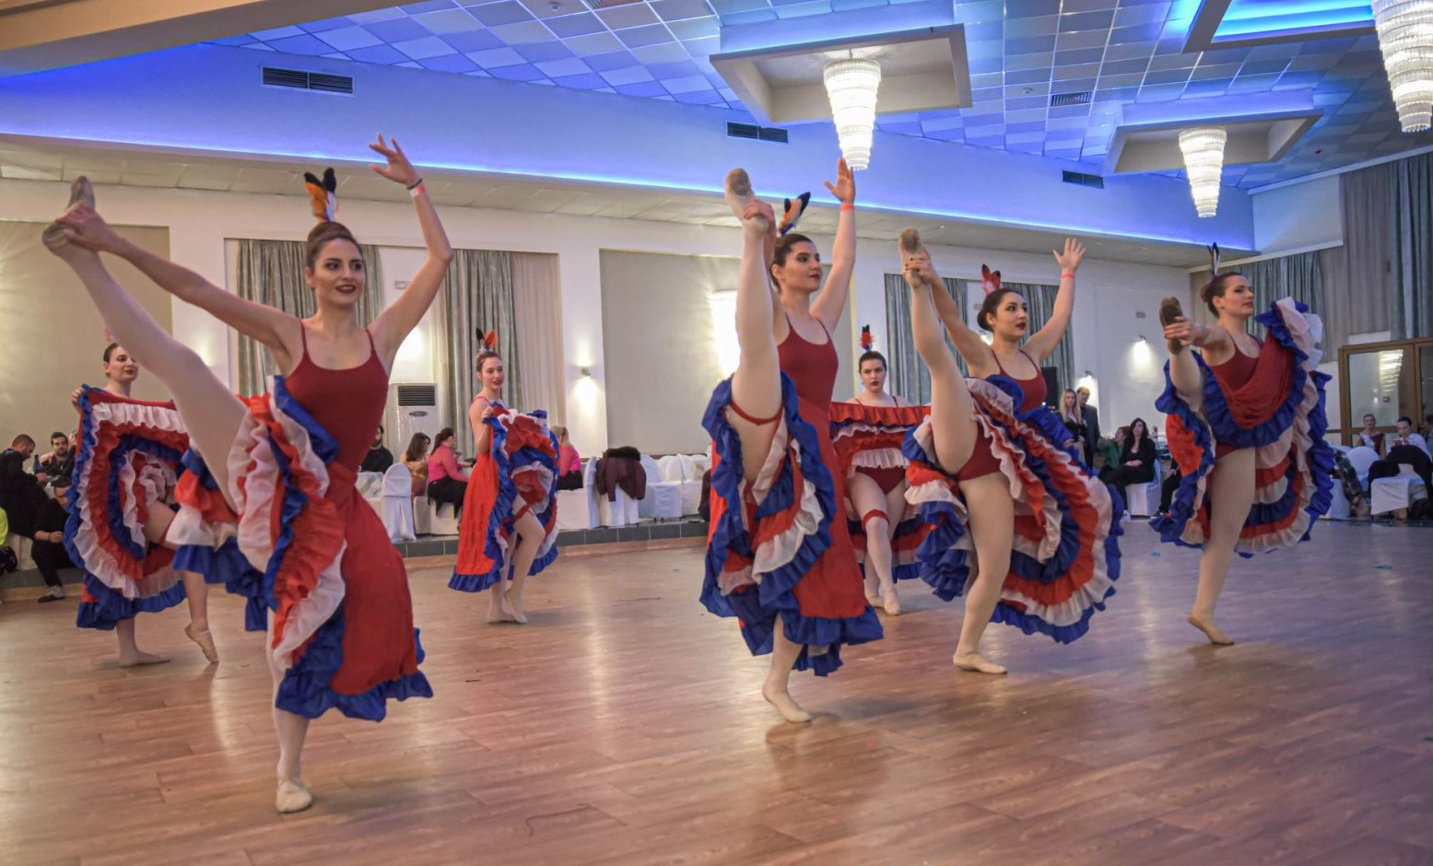
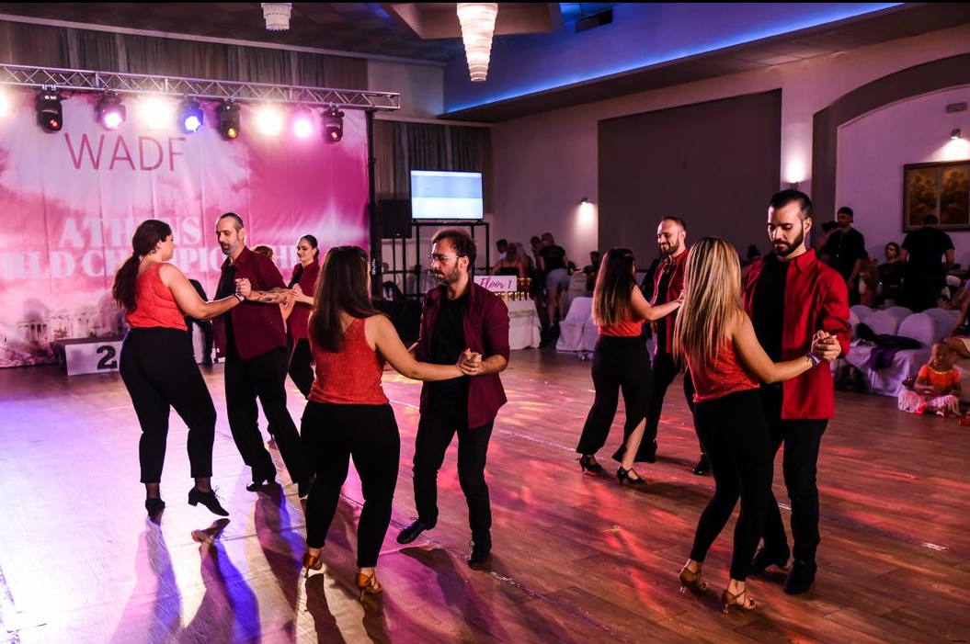

WORLD CUP CATEGORIES
ALL WADF STYLES
COUPLE FORMATION

Slide 12
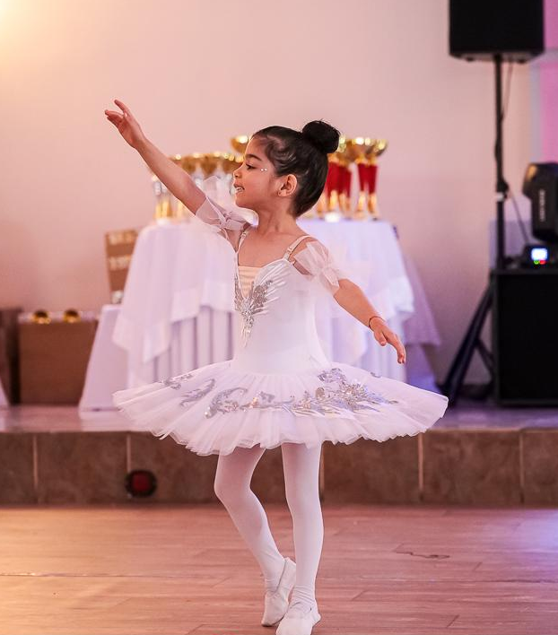
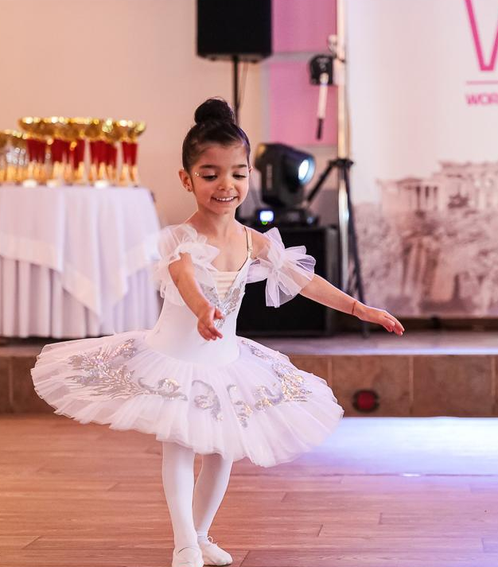
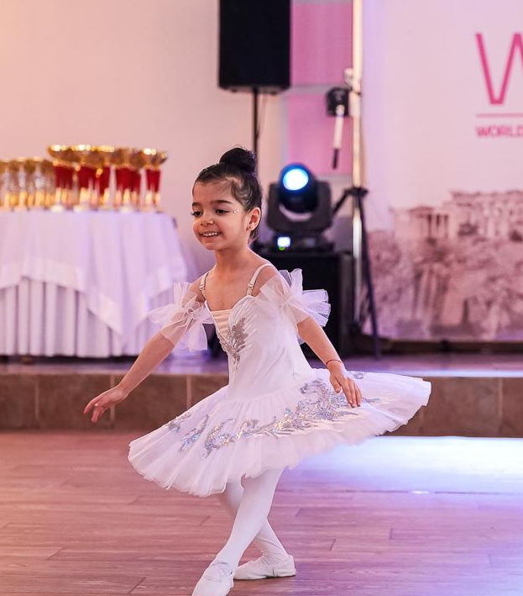
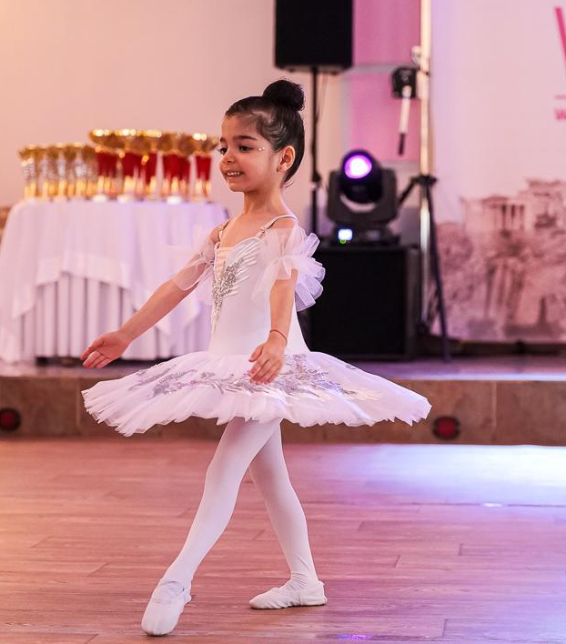
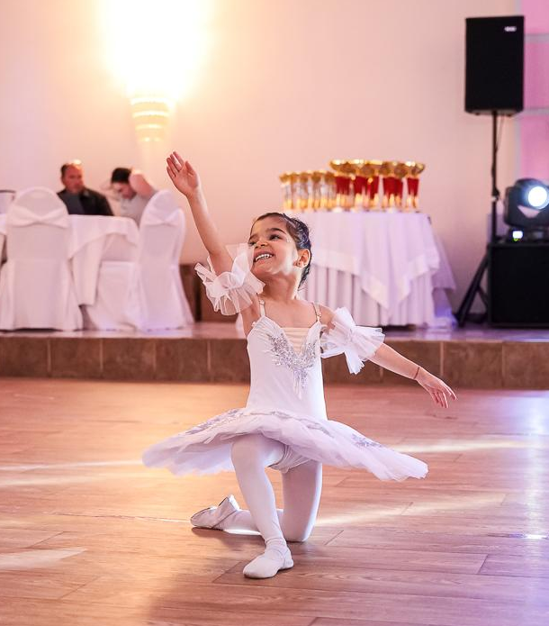
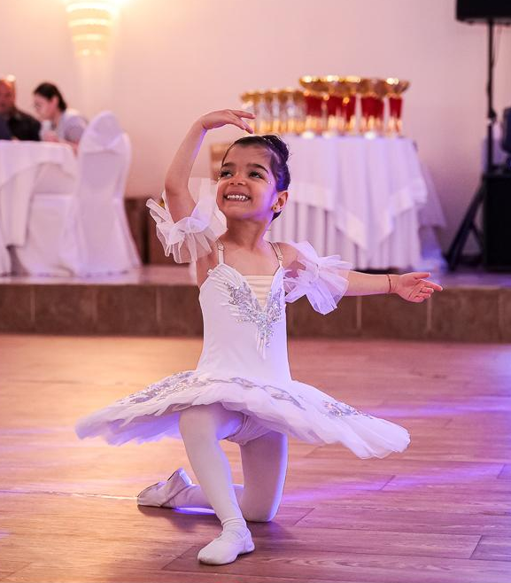
WORLD CUP CATEGORIES
Classical Ballet

Slide 13
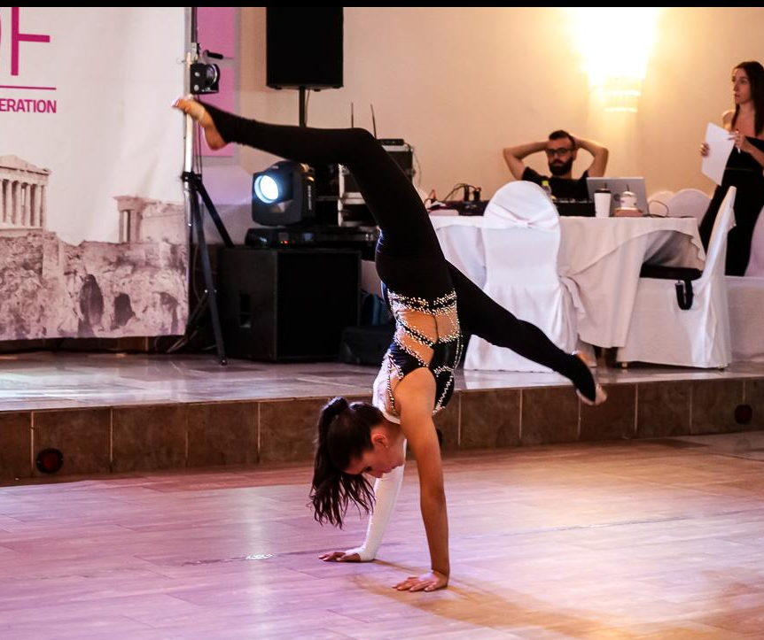
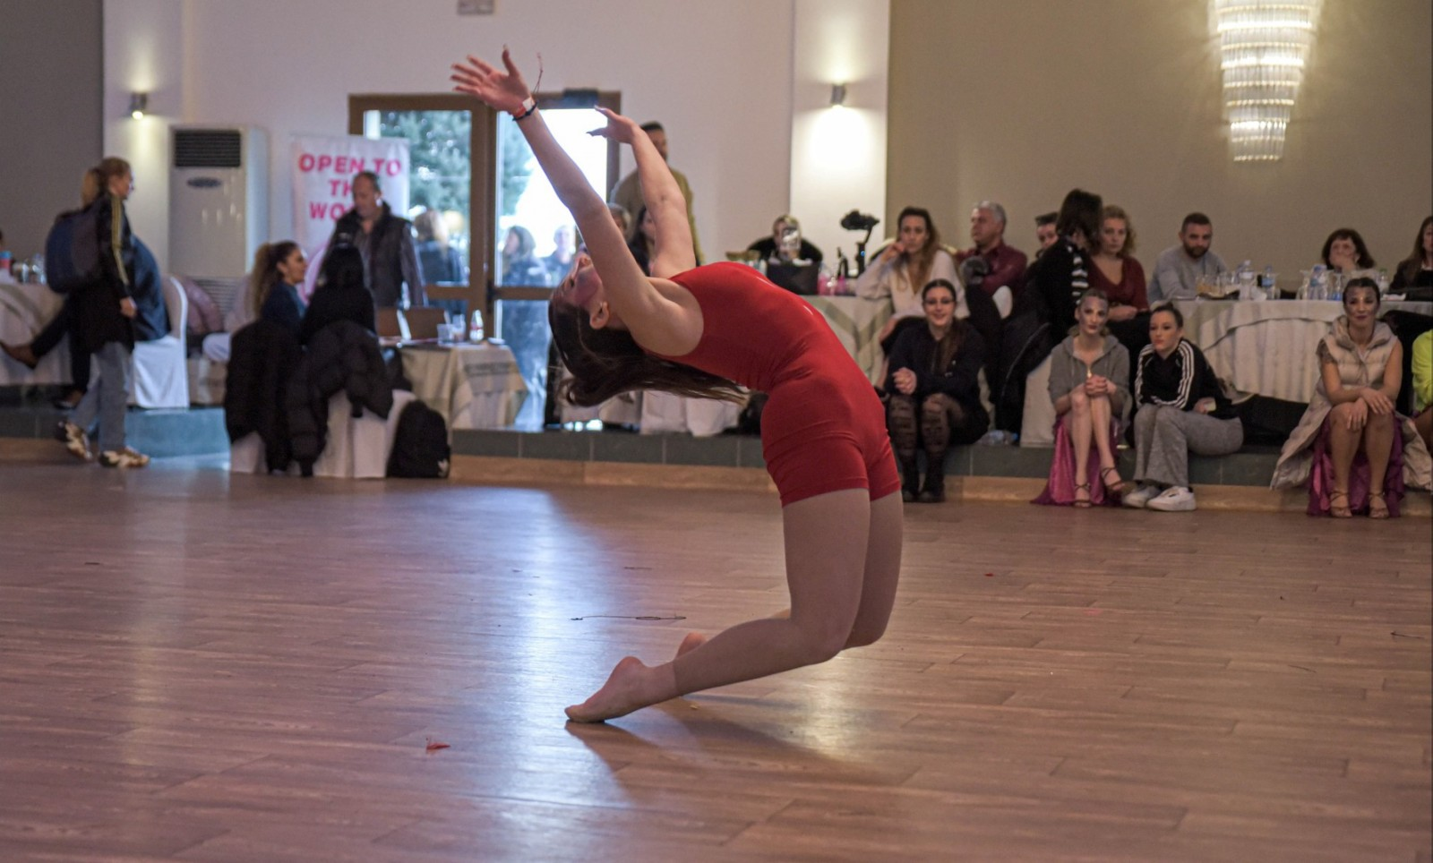
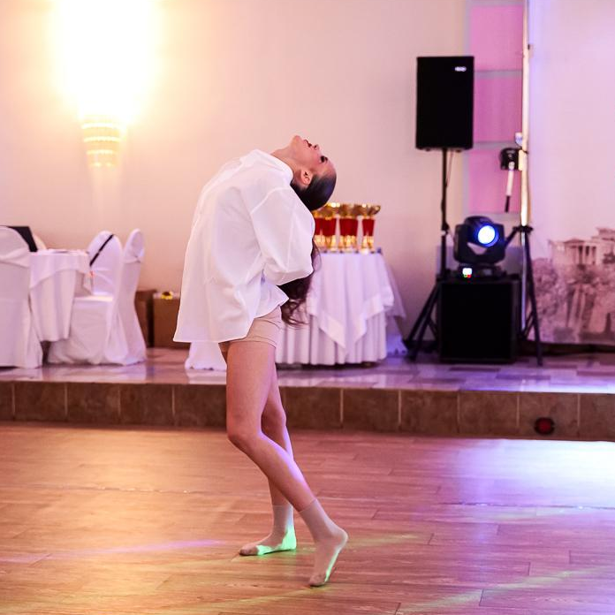
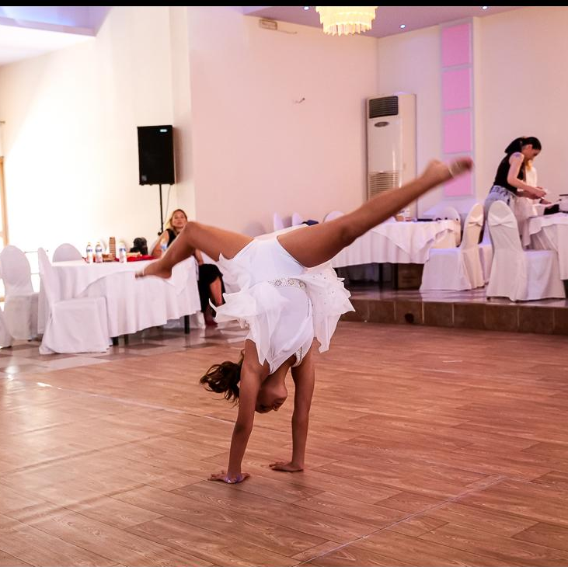
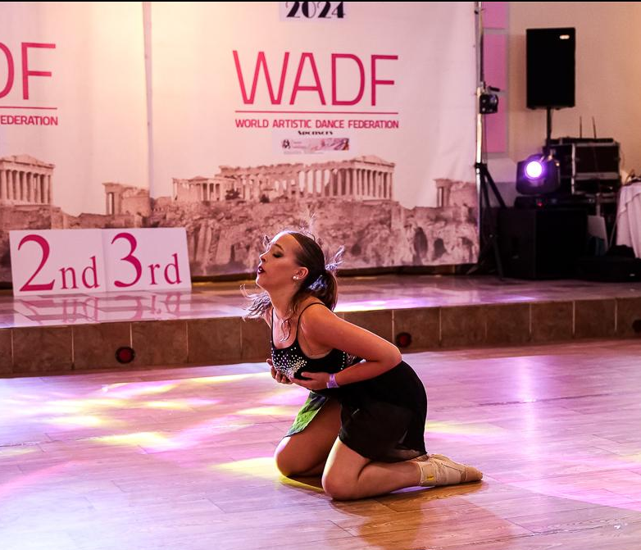
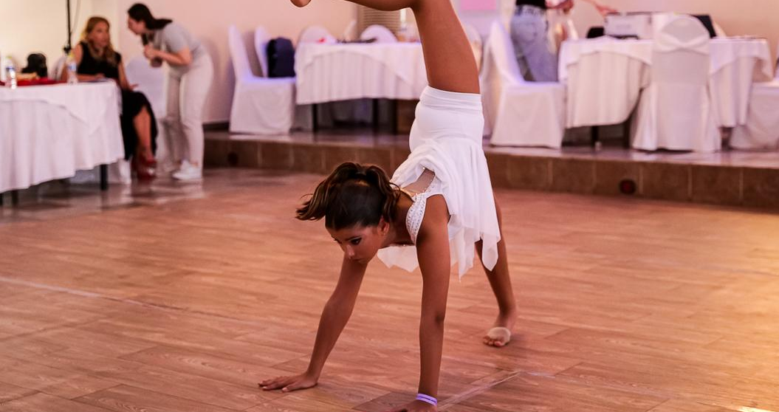
WORLD CUP CATEGORIES
Contemporary
Modern

Slide 14
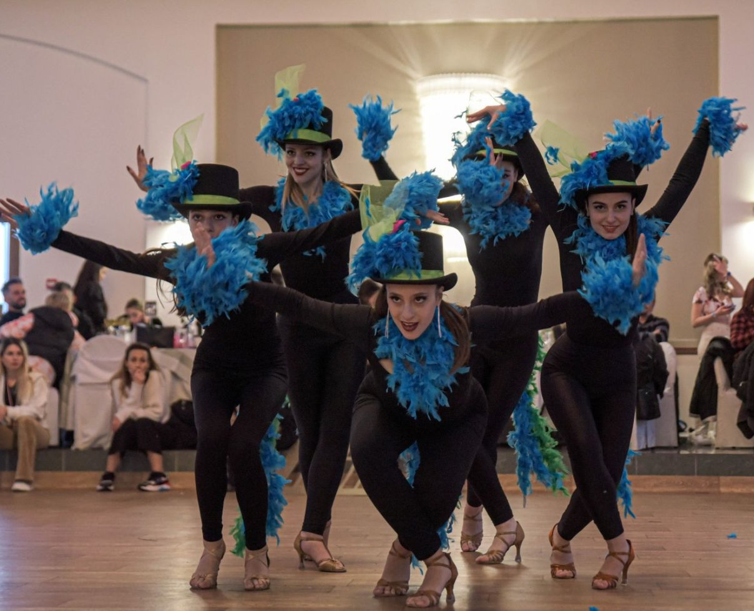
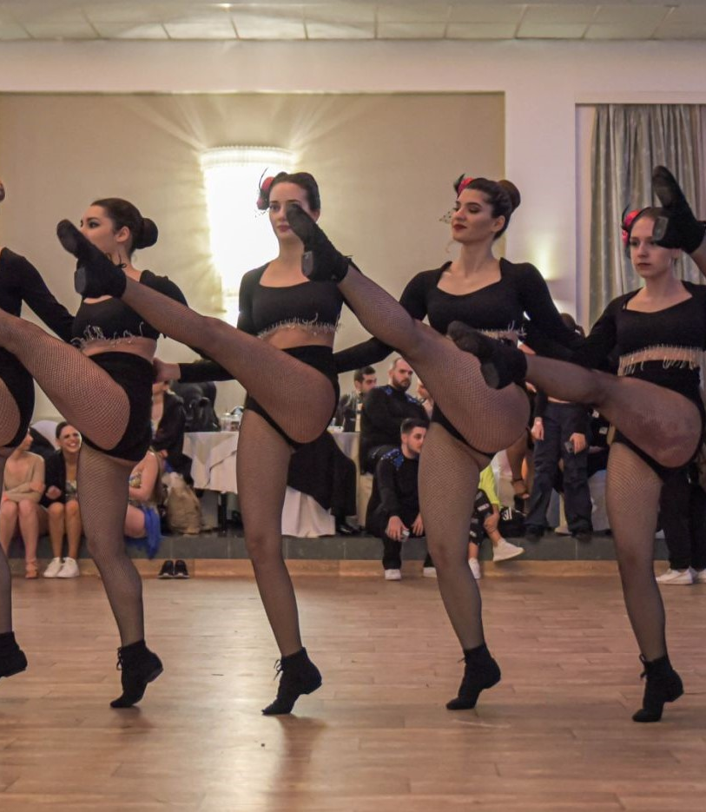
WORLD CUP CATEGORIES
Film & Musical
Jazz

Slide 15
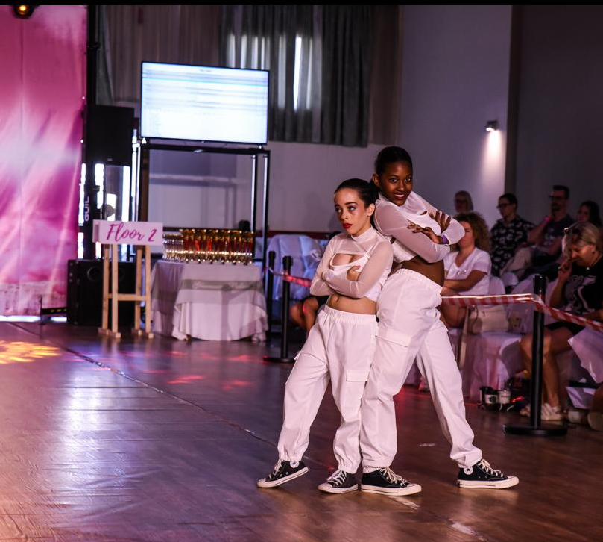
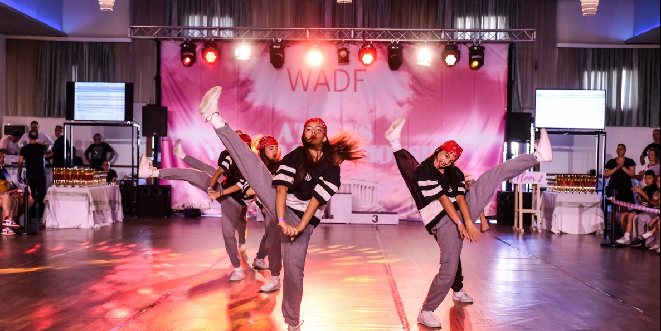
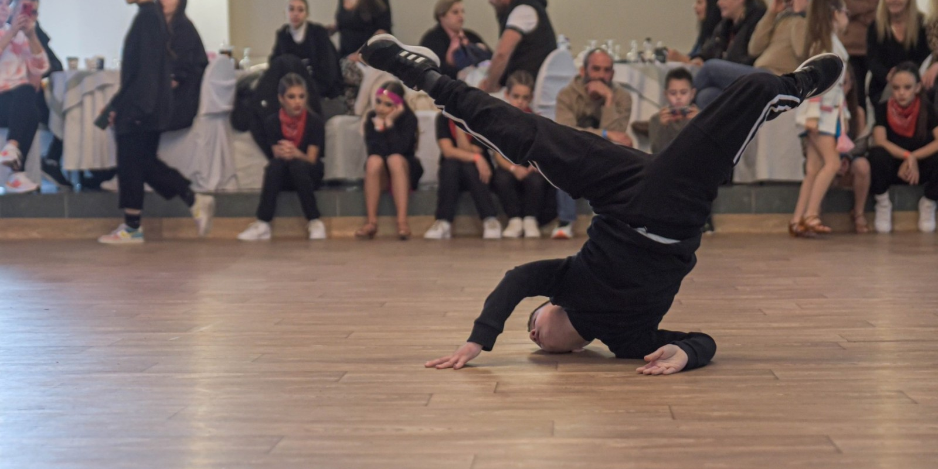
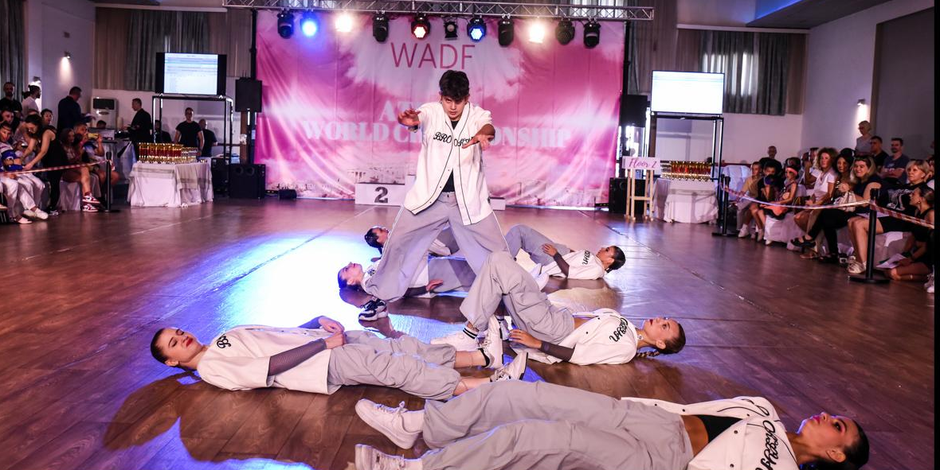
WORLD CUP CATEGORIES
Urban Street Dance
Break Dance
Commercial

Slide 16

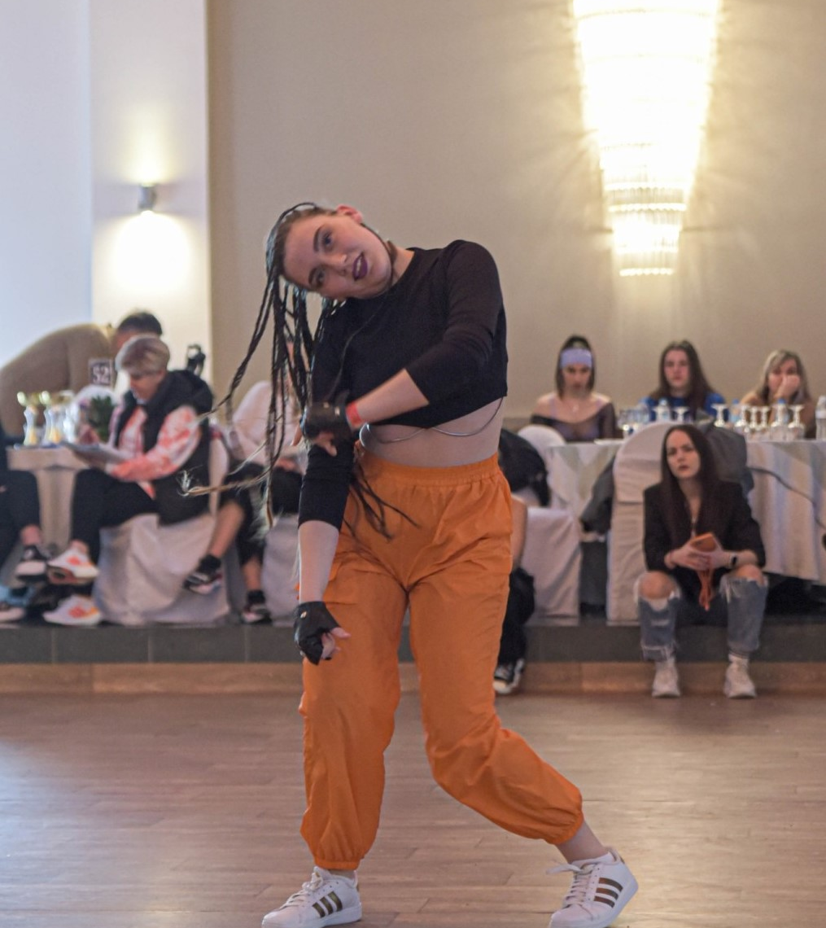
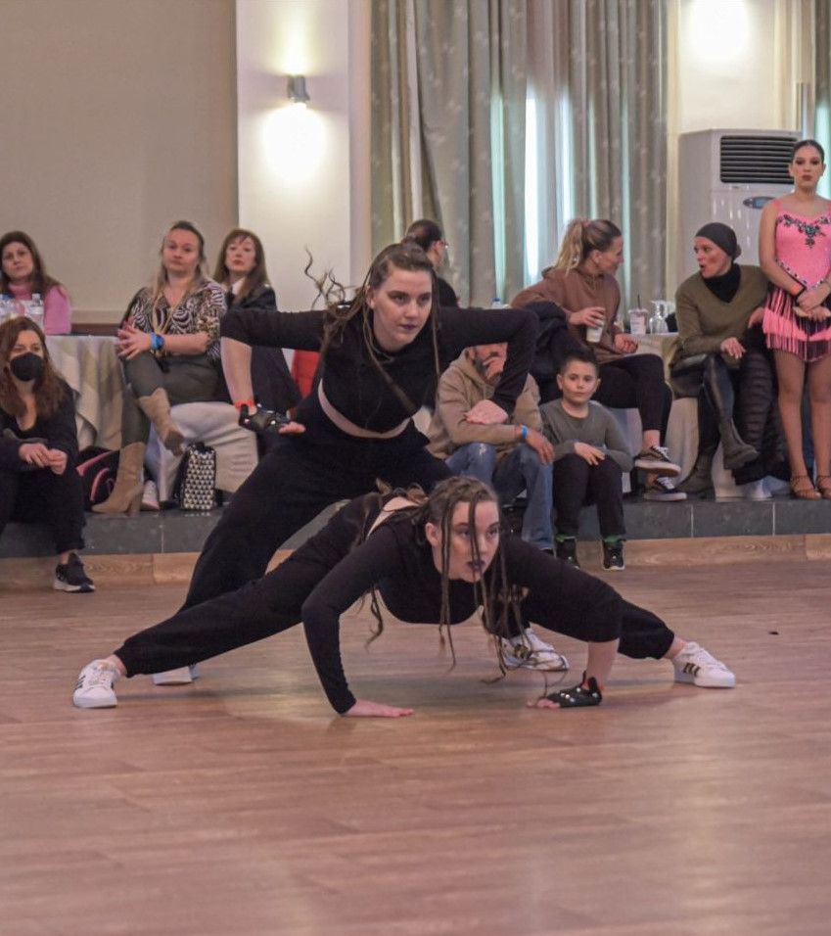
WORLD CUP CATEGORIES
Dance Hall

Slide 17
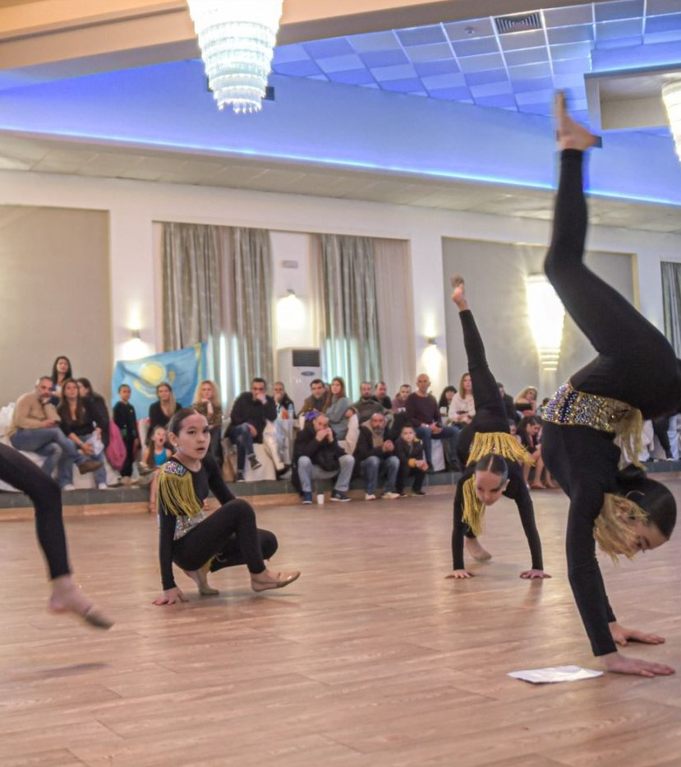
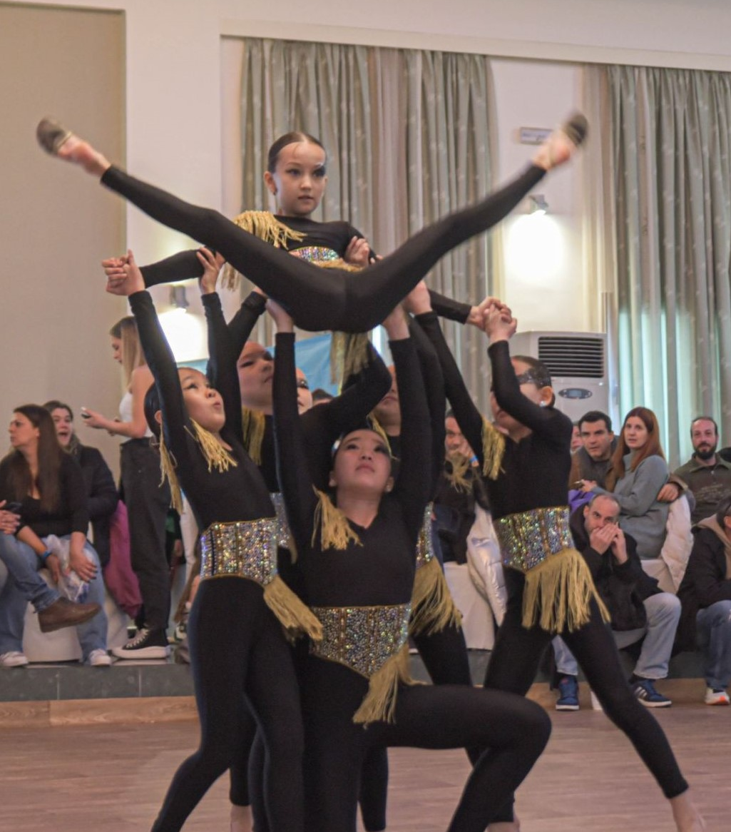
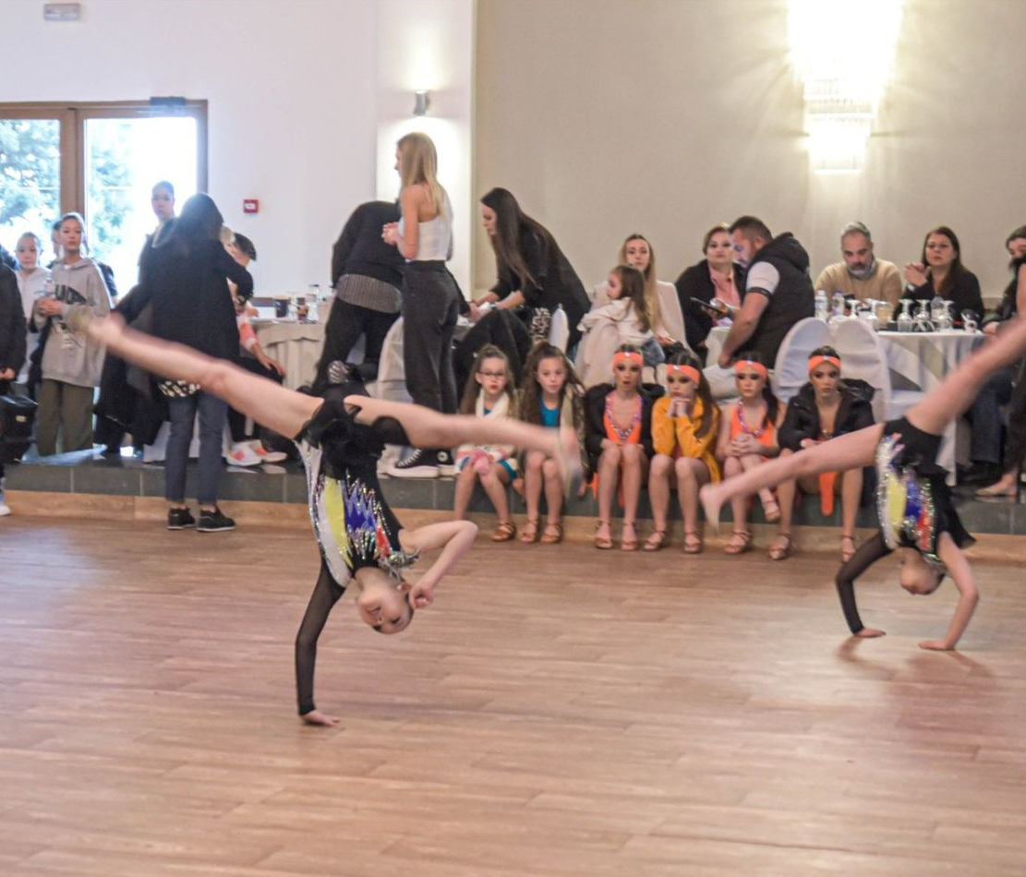
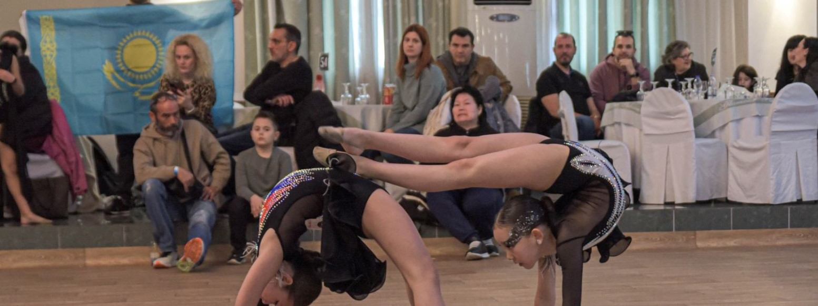
WORLD CUP CATEGORIES Artistic Acrobatic Dance Show

Slide 18
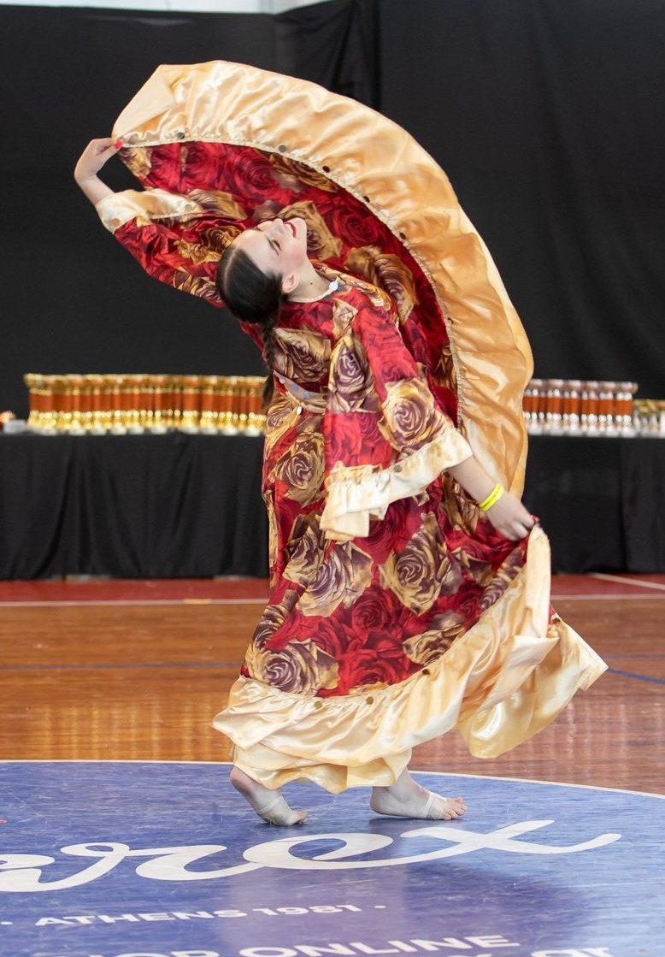

WORLD CUP CATEGORIES
Ethno
Bollywood
Flamenco

Slide 19


WORLD CUP CATEGORIES
4-dance Rising Star
Standard & Latin

Slide 20
GENERAL RULES
AGE CATEGORIZATION
Mini Kids (5-7 years)
Juveniles (8-11 years)
Junior (12-15 years)
Youth (16-20 years)
Adults (21-34 years)
Masters (35-44 years)
Grand Masters (45 and over)
CATEGORIES
Solo Female
Solo Male
Duos F/M, F/F, M/M
Couples F/M, F/F, M/M
Teacher – Student F/M, F/F, M/M
Trios (3 dancers of any gender
Small teams (4-8 dancers)
Large teams (9-16 dancers
Showcases 17-30 dancers
Super showcases 31 and more

Slide 21
TIME LIMITS
Solo, Duos, Trios
1.30 – 2 min
Small & Large Teams
2.30 – 3 min
Showcases
3.30 – 4 min
Super Showcases
3.30 – 5 min

Slide 22


COMPETITION HALL
ΑΣΟΧ ΦΟΙΒΟΣ

Slide 23



ACCOMMODATION
ANASTAZIA LUXURY SUITES & SPA
Argonauton Komninon 12, Drosia
Hotel website
Recommended

Slide 24



ACCOMMODATION
ACHARNIS KAVALLARI HOTEL SUITES
384 Parnithos Avenue (20th km Acharnes)
Hotel website
Recommended

Slide 25



ACCOMMODATION
PARNIS PALACE HOTEL SUITES
388 - 392 Parnithos Avenue (20th km Acharnes)
Hotel website
N
Recommended

Slide 26



ACCOMMODATION
HOTEL CAVALLARI PALACE
332 Parnithos Avenue, Acharnes
Hotel website
Near the hall
Recommended

Slide 27



ACCOMMODATION
HOTEL ACROPOL
Pentelis Avenue 71, Halandri
Hotel website
Recommended

Slide 28
IF YOU WISH TO BOOK YOUR ACCOMMODATION IN THE CENTER OF ATHENS OR AWAY FROM COMPETITION VENUE YOU CAN CONTACT US TO ORGANIZE YOUR TRANSFERS!
Contact details:
wadfgreece@gmail.com
WADF Greece

